Slide 1




JavaScript Development Introduction
First Steps in JavaScript
SoftUni Team
Technical Trainers
Software University
http://softuni.bg

Slide 2

Table of Contents
Static vs. Dynamic Languages
Dynamic HTML (DHTML)
Introduction to JavaScript
JavaScript in Web Pages
Integrating JavaScript in HTML
First Steps in JavaScript
JavaScript Syntax
JavaScript Objects

Slide 3
Static vs. Dynamic Languages
Static Languages
Explicit type declaration
Strongly typed
Type checking occurs on compile time
Statically-typed languages: C, C++, C#, Java
Dynamic (Scripting) Languages
Implicit type declaration
Weakly typed
Type checking occurs at run time
Dynamic languages: JavaScript, PHP, Python, Ruby
string name = "Pesho"
int age = 25;
var name = "Pesho"
var age = 25;

Slide 4
Compiler / Interpreter / Virtual Machine
A compiler converts a high level language code (like C#, Java) into machine code which is executed by the CPU or VM
Most errors are found at compile time, before execution
C and C++ use compilers to produce native code for the CPU
C# and Java use compilers to produce intermediate code for VM
An interpreter analyses and executes the script code line by line
Code is analyzed at runtime (no compilation)
Errors are found at runtime, during the code execution
JavaScript, Python, Ruby and PHP use interpreters

Slide 5
Compiler / Interpreter / Virtual Machine (2)
JIT (just-in time compilers) compile the code at runtime, during the execution, on demand
Available for Java, JavaScript and other languages
Compiled languages are faster than interpreted languages
C, C++, Go and Swift are very fast → compiled to native code for CPU
C# and Java are slower → compiled to intermediate code for VM
JS, Python, Ruby, PHP are even slower → interpreted / JIT-compiled
Virtual machine (JVM for Java, CLR for C# / .NET)
A virtual computer inside the computer, runs intermediate code

Slide 6

Dynamic HTML
Dynamic Behavior at the Client Side

Slide 7



What is DHTML?
DHTML: collection of technologies used together to create interactive web sites
Web pages to react and change in response to the user’s actions
DHTML is combination of HTML + CSS + JavaScript + DOM
DHTML
HTML
CSS
JavaScript
DOM

Slide 8
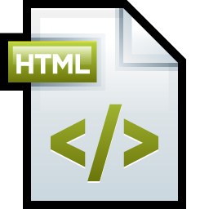
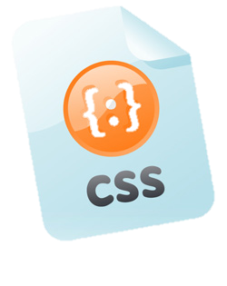

DHTML = HTML + CSS + JavaScript
HTML defines web sites content through semantic tags (headings, sections, articles, paragraphs, lists, …)
CSS describes the look and formatting of a document
Layout and Position of elements on the page
Presentation styles (background, borders, colors…)
Text and font styles (size, color, family)
JavaScript defines dynamic behavior
Programming logic for interaction with the user
Handle user events

Slide 9
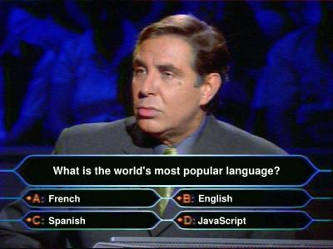
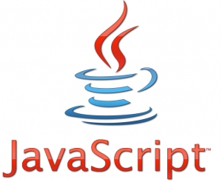
JavaScript
Dynamic Behavior in a Web Page

Slide 10

What is JavaScript?
JavaScript is a scripting programming language
Developed by Netscape for dynamic Web content
Lightweight, but with limited capabilities
Can be used as object-oriented language
Embedded in HTML page, interpreted by the Web browser
Client-side, server-side, mobile and desktop technology
Dynamic (scripting) language → weakly typed, runtime object alternation, functional programming, runtime code eval, etc.
Powerful to manipulate the DOM

Slide 11
JavaScript Advantages
JavaScript allows interactivity such as:
Dynamically load and change page content (through AJAX)
Implementing custom HTML UI controls
Sortable table, 3D charts, asynchronous file upload, …
Implementing advanced form validation
Respond to user actions, e.g. handle keyboard events
Performing complex calculations, e.g. SHA1 encryption
Implementing browser-based interactive games
Implementing Single Page Applications (SPA)

Slide 12
What Can JavaScript Do?
Can handle events, e.g. button clicks
Can read and write HTML elements and modify the DOM tree
Can access / modify browser cookies
Can detect the user’s browser and OS
Can be used as object-oriented language
Can perform asynchronous server calls (AJAX)
Can implement complex graphics / animation (through Canvas)
Can implement back-end logic (through Node.js)

Slide 13
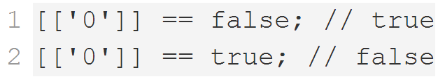
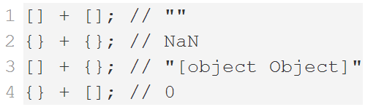
JavaScript Engines
JS engine – a virtual machine which interprets / executes JavaScript
Used in web Browsers
V8 in Chrome
Chakra in IE
Spidermonkey in Firefox
JavaScriptCore for Safari
Services
Memory management / GC
Just-in-Time compilation
Type System

Slide 14
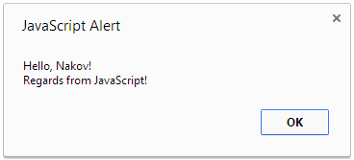
First Look at JavaScript Code
<html>
<body>
<script>
var name = "Nakov";
alert("Hello, " + name + "!\nRegards from JavaScript!");
</script>
</body>
</html>

Slide 15
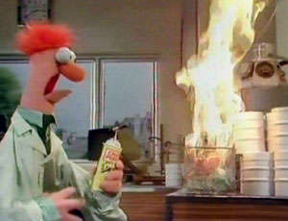
First Look at JavaScript
Live Demo

Slide 16
Using JavaScript Code
The JavaScript code can be placed in:
<script> tag in the head
<script> tag in the body
External files (recommended), linked via <script src="…">
Files usually have .js extension
The .js files are cached by the browser
<script src="scripts.js" type="text/javascript">
<!– code placed here will not be executed! -->
</script>

Slide 17
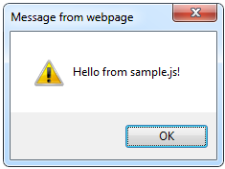
Using External Script Files
Using external JS files:
External JavaScript file (sample.js):
<html>
<head>
<script src="sample.js" type="text/javascript">
</script>
</head>
<body>
<button onclick="alertMessage()" value="Call JavaScript function from sample.js" />
</body>
</html>
external-JavaScript.html
The <script> tag is always empty. Cannot be <script … />.
function alertMessage() {
alert('Hello from sample.js!')
}
sample.js

Slide 18
Modern Approach to Load JS Files
Attributes (async and defer) load a script in background
Without pausing the HTML parser
async
Executed asynchronously as soon as the script is downloaded
Without blocking the browser in the meantime
defer
Executed in after the entire document has been loaded
<script src="scripts.js" async></script>
<script src="scripts.js" defer></script>

Slide 19
JavaScript – When is Executed?
JavaScript code is executed during the page loading or when the browser fires an event
All statements are executed at page loading
Some statements just define functions that can be called later
No compile-time checks (JavaScript is dynamic language)
Function calls or code can be attached as "event handlers"
Executed when the event is fired by the browser
<img src="softuni.gif" onclick="alert('Clicked!')" />

Slide 20
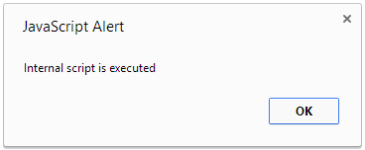
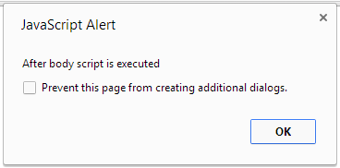
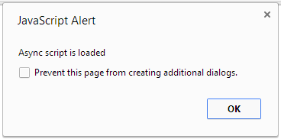
Executing JavaScript Code
Live Demo

Slide 21
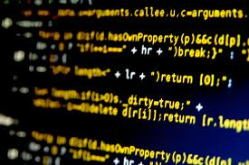

The JavaScript Syntax

Slide 22
JavaScript Syntax
The JavaScript syntax is similar to C#
Operators (+, *, =, !=, &&, ++, …)
Variables (typeless)
Conditional statements (if, else)
Loops (for, while)
Arrays (my_arr[5]) and associative arrays (my_arr['abc'])
Functions (can return value)
Function variables (variables holding a function reference)

Slide 23
Standard Popup Boxes
Alert box with text and [OK] button
Just a message shown in a dialog box:
Confirmation box
Contains text, [OK] button and [Cancel] button:
Prompt box
Contains text, input field with default value:
alert("Some text here");
confirm("Are you sure?");
prompt("enter amount", 10);

Slide 24
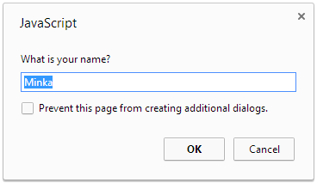
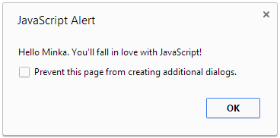
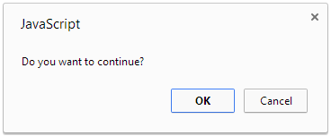
Syntax and Popup Boxes
Live Demo

Slide 25
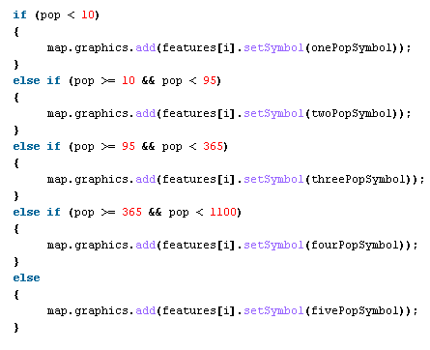
Event Handlers

Slide 26
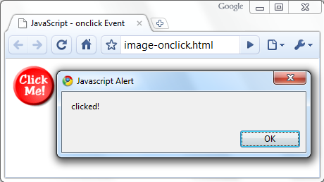
Calling a JavaScript Function from Event
<html>
<head>
<script type="text/javascript">
function clickHandler(message) {
alert(message);
}
</script>
</head>
<body>
<img src="logo.gif"
onclick="clickHandler('clicked!')" />
</body>
</html>

Slide 27
Event Handlers in JavaScript
Live Demo

Slide 28

Other JavaScript Objects

Slide 29
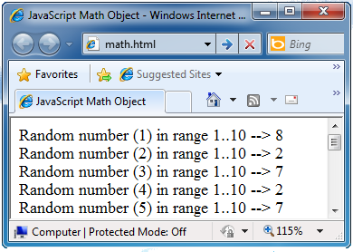
The Math Object
The Math object provides some mathematical functions
math.html
for (var i=1; i<=20; i++) {
var x = Math.random();
x = 10*x + 1;
x = Math.floor(x);
document.write(
"Random number (" +
i + ") in range " +
"1..10 --> " + x +
"<br/>");
}

Slide 30
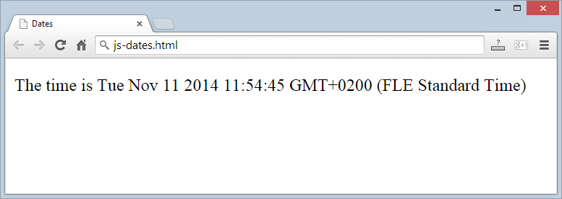
The Date Object
The Date object provides date / calendar functions
dates.html
var now = new Date();
var result = "The time is " + now;
document.getElementById("timeField").innerText = result;
…
<p id="timeField"></p>

Slide 31
Timers: setTimeout()
Make something happen (once) after a fixed delay
var timer = setTimeout('bang()', 5000);
5 seconds after his statement executes, this function is called
clearTimeout(timer);
Cancels the timer

Slide 32
Timers: setInterval()
Make something happen repeatedly at fixed intervals
var timer = setInterval('clock()', 1000);
This function is called continuously per 1 second.
clearInterval(timer);
Stops the timer.

Slide 33
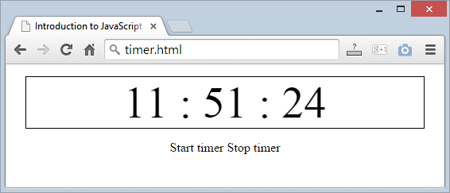
Timer – Example
timer-demo.html
<script type="text/javascript">
function timerFunc() {
var now = new Date();
var hour = now.getHours();
var min = now.getMinutes();
var sec = now.getSeconds();
document.getElementById("clock").value =
"" + hour + ":" + min + ":" + sec;
}
setInterval('timerFunc()', 1000);
</script>
<input type="text" id="clock" />

Slide 34
Other JavaScript Objects
Live Demo

Slide 35
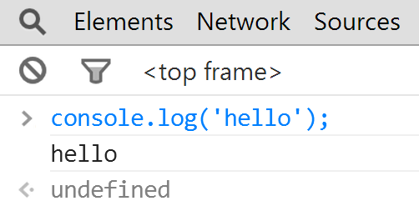
JavaScript Console Object
The console object exists only if there is a debugging tool that supports it
Used to write log messages at runtime
Methods of the console object:
debug(message)
info(message)
log(message)
warn(message)
error(message)

Slide 36


Summary
DHTML = HTML + CSS + JavaScript + DOM
JavaScript – dynamical scripting language
Executed in the Web browsers / server-side
Enables dynamic behavior
Other JavaScript objects
JS Basics

Slide 37







JavaScript Development Introduction
https://softuni.bg/courses/javascript-basics

Slide 38
License
This course (slides, examples, demos, videos, homework, etc.) is licensed under the "Creative Commons Attribution-NonCommercial-ShareAlike 4.0 International" license
Attribution: this work may contain portions from
“JavaScript Basics" course by Telerik Academy under CC-BY-NC-SA license

Slide 39





Free Trainings @ Software University
Software University Foundation – softuni.org
Software University – High-Quality Education, Profession and Job for Software Developers
softuni.bg
Software University @ Facebook
facebook.com/SoftwareUniversity
Software University @ YouTube
youtube.com/SoftwareUniversity
Software University Forums – forum.softuni.bg

